Slide 1
Stock Movement Forecaster App: Warren Buffet ‘Invest For Me’
Team: DataJhoom
Eric Gieseke
Sriram Moorthy
Anindita Mahapatra

Slide 2
Case against Efficient Market Hypothesis
It is possible to “beat the market”
Investors, such as Warren Buffett have consistently beaten the market over long periods of time, which by definition is impossible according to the EMH !
Leverage social media to build indicators that can predict stock trends

Slide 3
Pitch
Predict stock price movement based on social sentiments
Monitor twitter feed to capture word frequency associated with a stock
Track current stock price
Feed ML Lib with Stock Price Change & word:frequency for each stock and generate a model for training data
Continuously update and apply the model to test data real time to predict stock price to predict say buy/hold/sell ?
Notify app of Buy/Sell/Hold Recommendations

Slide 4
Virtual Investment
Test Indicators & Build Confidence
Act on the app recommendations
Calculate returns over a period of time risk free

Slide 5
Technology Choices
Core Spark (Scala based)
Spark Streaming (to capture twitter feed)
Spark MLLib (to build model)
Nodejs for pushing results to UI
Web based UI (Bootstrap)

Slide 6
Architecture
Spark Scala Streaming App to capture stock sentiment
Twitter stream
Spark Scala MLLib App to compute model on data
stock | price | Recommendation
MSFT
NOK
Delta in Stock Price
Spark MLLib App to apply/update model
Twitter Stream
App
Push channel
Node.js Web Service

Slide 7
Components
Twitter Stream | Model Builder | Stock Predictor
Filter on company name Collect words in tweet within 2 sliding windows One to feed the model Other to apply the model Use Yahoo YQL to fetch stock quote at beginning/end of window Filter out stop words Update word count Select Top N words as features If delta stock price is positive, recommend If static, hold If negative, sell Write out to file | Read data file created (movement feature List) Apply Logistic Regression multiclass classification algorithm from MLLib to train/test the data Save company specific model This is an iterative process, so model is constantly learning and updating itself | Load the model Read in the latest word count feature set Apply the model to predict movement in stock price Post the prediction to a REST web service which updates a web page

Slide 8

WarrenBuffet By DataJhoom

Slide 9
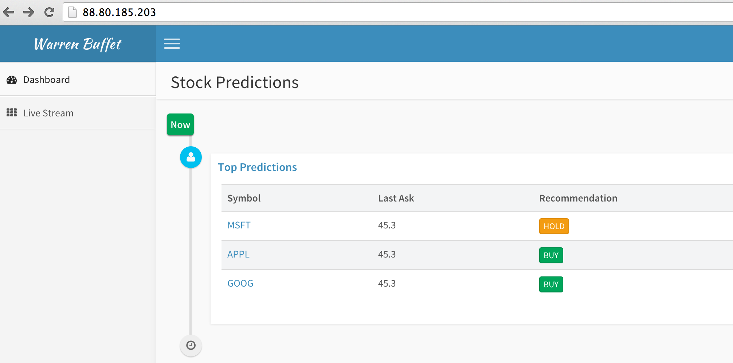
Stock Movement Predictor

Slide 10
Code
IBM spark server (158.85.71.206)
/uploads
stock-sentiment-1.0.0.jar
/hackathon
run_data_feeds.sh
run_model.sh
run_predict.sh

